Slide 1
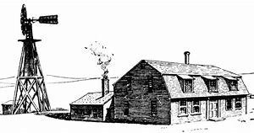
Toward Preserving Washington’s USDA RD Affordable Housing
Kelly Owen
Northwest Justice Project Jan. 2020

Slide 2
A Brief Primer on Prepayment of USDA Rural Develoment Loans
USDA RD complexes are generally privately owned, built with long term, very low-interest loans. Owners receive ongoing RD operating subsidies
Owners can prepay loan and come out of USDA program if they follow federal laws on prepayment.
Owner has 2 choices to prepay:

Slide 3
A Brief Primer on Prepayment of USDA Rural Develoment Loans
Owner may market property for 180 days for nonprofit purchase, which would preserve it as RD housing. If no nonprofit makes purchase offer within 180 days, property goes out of USDA program with no limit on rent increases or other tenant protections. 8 Washington properties totaling 246 units marketed since 2012 did not receive a purchase offer, so were lost as affordable housing.
Owner may go out of RD program after signing and recording a recorded agreement meant to protect existing tenants (those living in building at prepayment) from rent increases and eviction. But these agreements have not been effective and do not preserve housing.

Slide 4
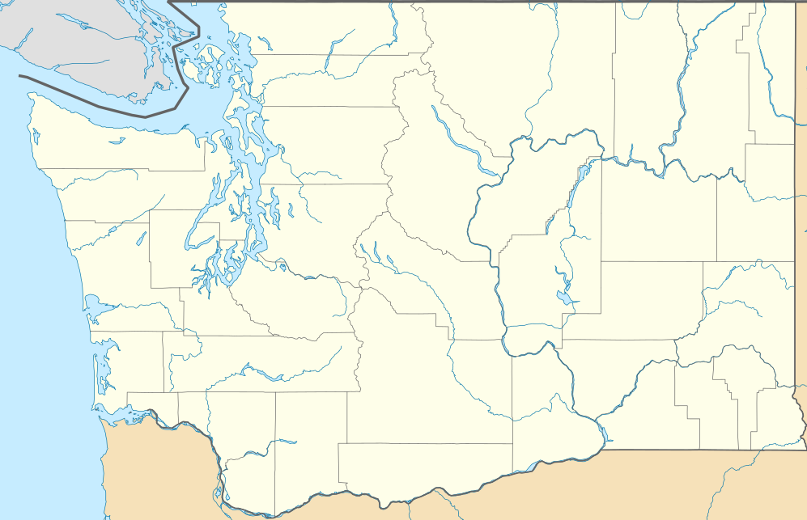
Washington Lost 533 USDA Apartment Units To Prepayment 2012-2019
Whatcom 6 bldgs.
103 units
San Juan; 1 bldg., 19 units
Skagit; 1 bldg.,
32 units
Island; 2 Bldgs., 64 units
Snohomish
2 bldgs.
123 units
Kitsap; 3 Bldgs., 94 units
Pierce; 2 Bldgs, 68 units
Yakima
2 bldgs.
30 units
Notes:
USDA Housing: mostly privately owned built and operated with USDA subsidies. 50 year loan, prepay

Slide 5
Laurelwood Apartments Gig Harbor
Senior/Disabled Housing
28 Units
Marketed to Nonprofits 180 days
No buyer
Out of USDA program Late 2018

Slide 6
In the words of one Laurelwood Tenant
A senior woman living on Social Security at under 150% of FPL, she gets an RD voucher to help pay the rent, but the voucher won’t ever increase, no matter how much rent does.
Her rent went up $100 a month after Laurelwood came out of the USDA RD program in October 2018.
“I’m afraid of the rent going up so much I can’t pay it, so I tried to find another USDA building to move into. But the waitlist is four to five years…. The new owner is renting some of the units furnished at $2,200 per month. I’m afraid that’s what they want to do.”
She reports that a letter from the owner said that half the RD tenants have already moved out due to fears of rent increases.

Slide 7
A Model for Preservation: Opportunity Council Preserves Friday Harbor Complex
Harbor View Apartments
Friday Harbor WA
Total Units: 20
Units with Subsidy: 19
Complex Type: Family
Bedrooms:
1 Bdr. 12
2 Bdr. 8

