Slide 1
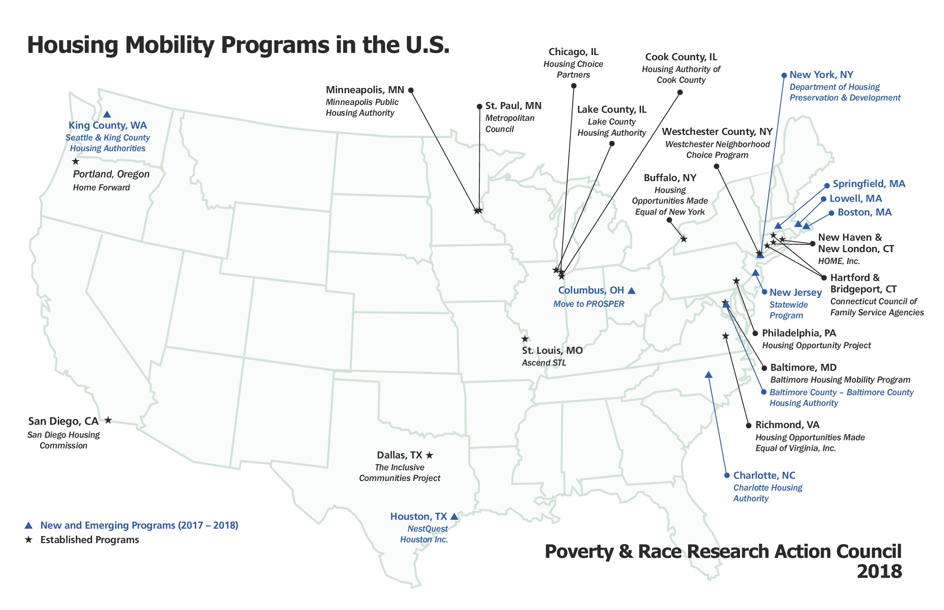

Slide 2
Housing Mobility: Federal Policy Context
Small Area Fair Market Rents
AFFH
MTW
RAD
PHA reforms: admin fees, consortia, SEMAP
Housing Mobility Demonstration

Slide 3
HUD Housing Mobility Demonstration
$25 million to support mobility for families with children
$5 million – additional incremental voucher assistance
$20 million – mobility services, eg counseling, administrative, rent deposits
Use of funds
Admin feeds: related services e.g., counseling, portability coordination, landlord outreach, security deposits, and administrative activities
HAP funds for security deposits in opportunity areas
Requirements (*selection criteria developed by HUD – TBD)
PHAs with high concentration in poor areas; available units in high-opportunity areas
Planned or current consortium or “partial consortia” : high-performing FSS/allow relocation
Planned or current consortium or “partial consortia” : incl small PHA, consolidate mobility operations
“Others that the Secretary may designate”

Slide 4
HUD Housing Mobility Demonstration: Requirements for Regional Plan
1) identify the PHAs that will participate & # of vouchers each participating agency will make available out of their existing programs;
(2) identify any community-based organizations, nonprofit organizations, businesses, and other entities that will participate & describe the commitments for such participation made by each such entity;
(3) identify any waivers or alternative requirements requested;
(4) identify any specific actions that the PHAs & other entities will undertake to accomplish the goals of the demo, which shall include a comprehensive approach to enable a successful transition to opportunity areas and may include counseling and continued support for families;
(5) specify the criteria that the PHAs would use to identify opportunity areas;
(6) provide for establishment of priority and preferences for participating families, including a preference for families with young children, as such term is defined by the Secretary, based on regional housing needs and priorities; and
(7) comply with any other requirements established by the Secretary.

Slide 5
Considerations for Developing a Regional Housing Mobility Plan
Program goals: population to be served, target annual number of mobility moves
Options for pre-move counseling and removal of tenant barriers to moving
Options for landlord recruitment and incentives
Identifying and addressing PHA policies and practices that contribute to concentration
Branding
Post-move support

Slide 6
Additional Resources:
Housing Mobility Demonstration bill language:
https://www.cbpp.org/sites/default/files/atoms/files/2-27-19hous-demolang.pdf
Mobility Works technical assistance group: https://www.housingmobility.org/
PRRAC resources on HCV reform:
https://prrac.org/all-articles-under-the-housing-mobility-initiative/

