Slide 1
Small Area Fair Market Rents
Natalie N. Maxwell
Florida Legal Services
natalie@floridalegal.org

Slide 2
What is the Small Area Fair Market Rent (SAFMR) Rule?

Slide 3
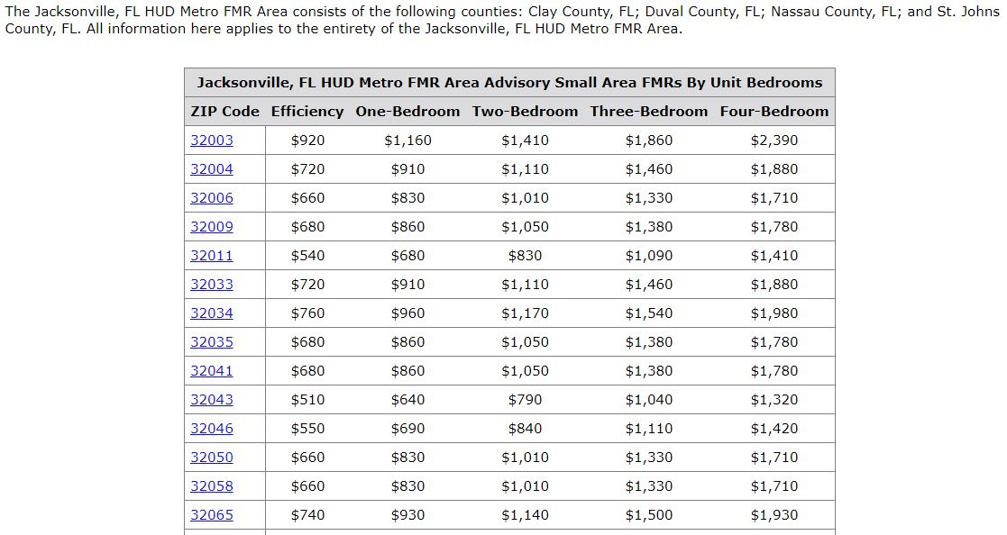
Jacksonville SAFMR

Slide 4
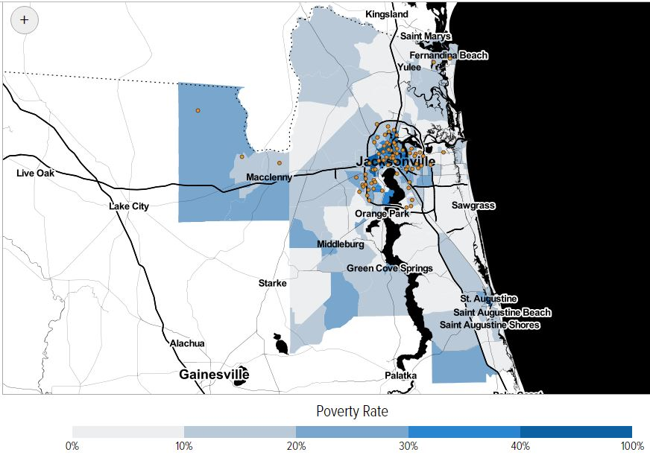
Jacksonville Voucher Utilization Map
Center on Budget and Policy Priorities and the Poverty & Race Research Action Council interactive mapping tool

Slide 5
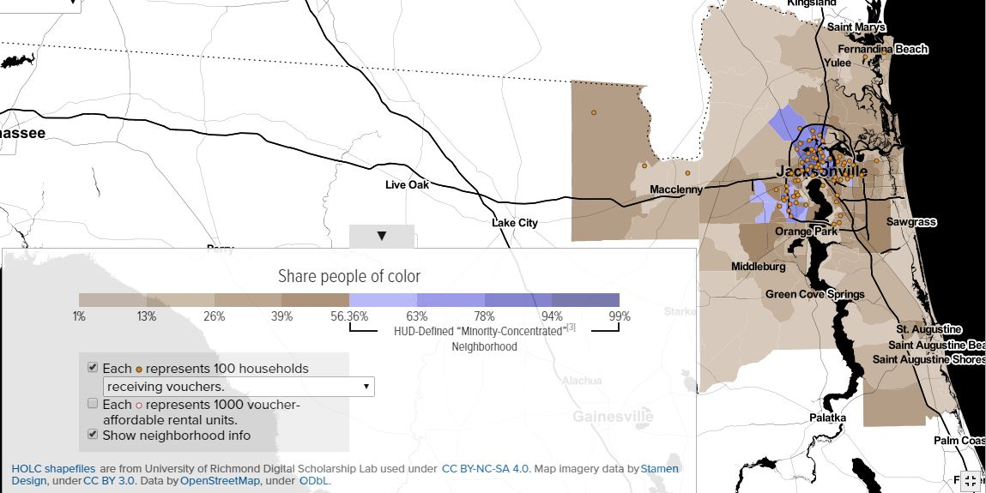
Jacksonville Voucher Utilization Map
Center on Budget and Policy Priorities and the Poverty & Race Research Action Council interactive mapping tool

Slide 6
SAFMR Implementation in Florida

Slide 7
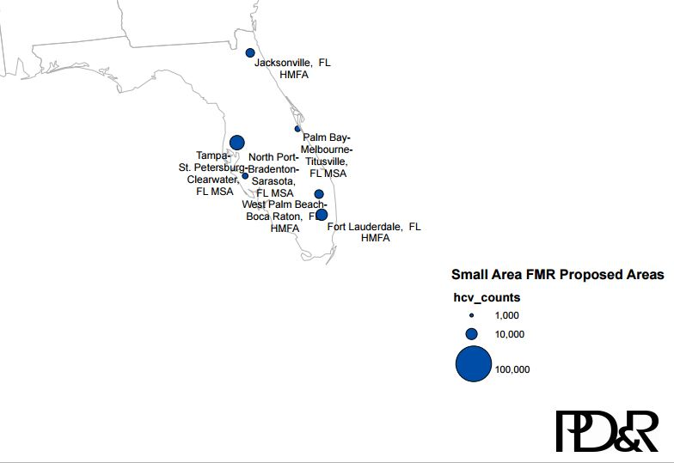
Florida Mandatory SAFMRs
Notes:
Fort Lauderdale-Pompano Beach - Deerfield Beach, FL Metro Division
Jacksonville HMFA
North Port - Bradenton - Sarasota MSA
Palm Bay - Melbourne - Titusville MSA
Tampa - St. Petersburg - Clearwater MSA
West Palm Beach - Boca Raton - Delray Beach MSA
“HUD’s new policy requires agencies in 24 metropolitan areas to use SAFMRs starting in January 2018 and allows agencies in these and any other areas to use SAFMRs beginning January 17, 2017.” Fischer (2016)

Slide 8
Opportunities for Advocacy
Actually Implementing SAFMR
Notices provided to Tenants
Payment Standards
Challenges to Rent Reasonableness
Low Income Housing Tax Credit Properties
Opting in to SAFMR

Slide 9
Resources
NHLP Fair Market Rent Page
NHLP SAFMR Memo To HJN
NHLP & PRRAC Advocates’ guide to successful implementation of the mandatory Small Area FMR rule
HUD Small Area Fair Market Rent page

