Slide 1
Basics of Mobility
Andrea Juracek
Executive Director

Slide 2
Housing Choice Partners
Founded in 1995 to address extreme HCV concentration in southern Cook County suburbs
501(c)3 nonprofit
Mission: help families break the cycle of intergenerational poverty through promotion of racial and economic diversity in housing
Currently under contract with Chicago Housing Authority to administer mobility counseling program

Slide 3
HCP/CHA Mobility Program
15 full-time, 1 part-time staff
2017-2018 contract year:
Approx. 1200 participants enrolled; 400 (30%) moved to Opportunity Areas
Eligibility
Goals
Must have at least 45 days left on voucher
Be in “good standing” with CHA and current landlord
Provide opportunity to make an informed housing choice
Assist low-income families in addressing barriers to moving into higher-cost areas

Slide 4
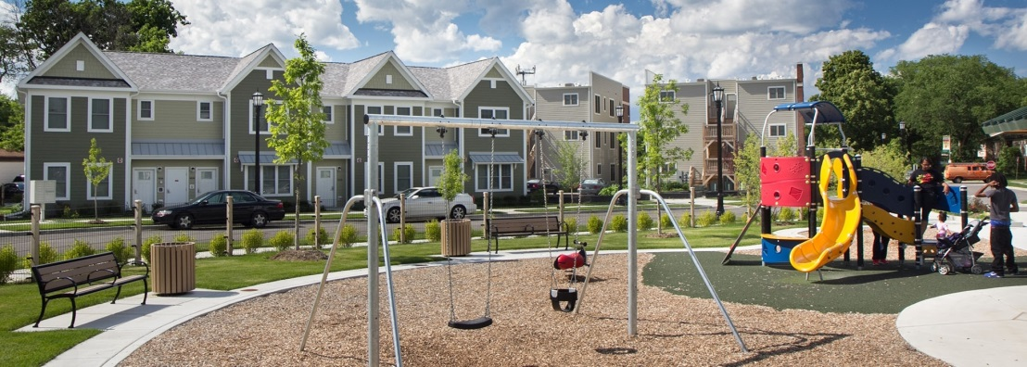
How We Define Opportunity
Many definitions over the years
2018 changes:
“Opportunity” Areas ➔ “Mobility” Areas
Census tracts ➔ Chicago Community Areas
20% or less poverty
Less than median reported violent crimes
Improving poverty and violent crimes along with job growth

Slide 6
HCP’s Core Program Elements
Pre-move counseling
Orientation and workshops
Opportunity community tours
Housing search assistance
Focus on helping families with children move to well-performing schools
Dedicated landlord outreach staff, LL financial incentives (CHA)
Community partnerships to address family needs
$500 security deposit/move-in fee assistance
Post-move support

Slide 7
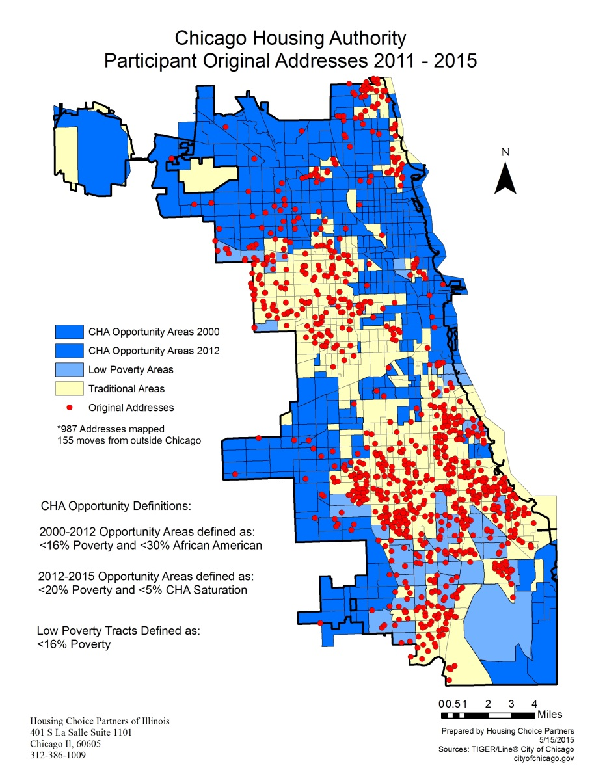
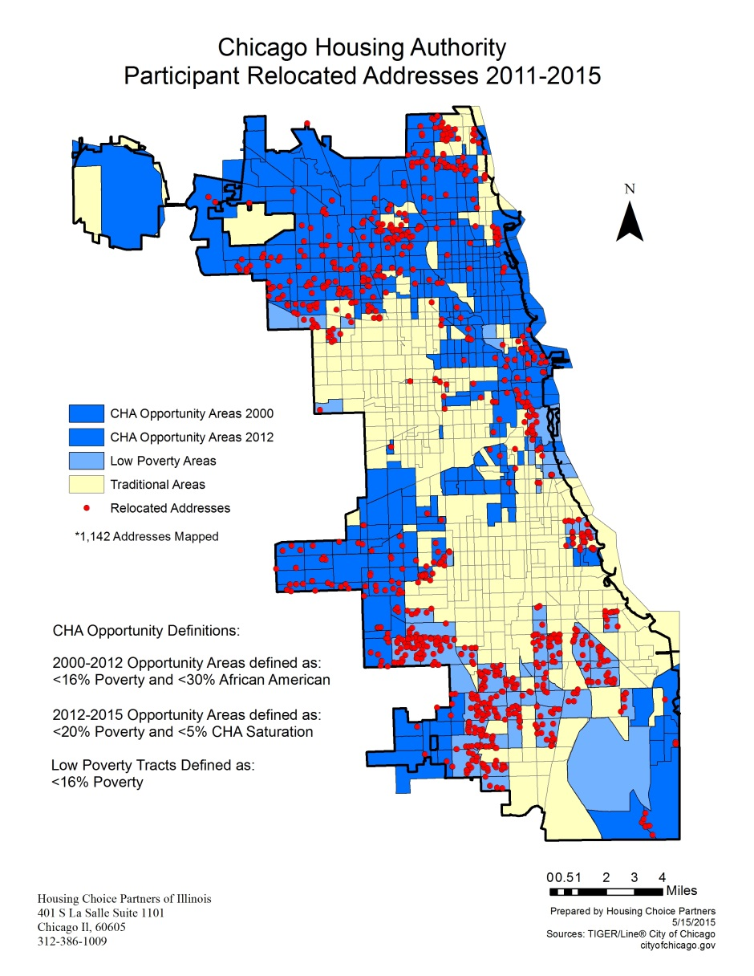
Mobility Program Moves to Opportunity Areas

Slide 8
401 S LaSalle St, Ste 1101
Chicago, IL 60605
(312) 386-1009
www.housingchoicepartners.org

